Slide 1

Model View Controller (MVC)
Charles Severance
www.dj4e.com

Slide 2

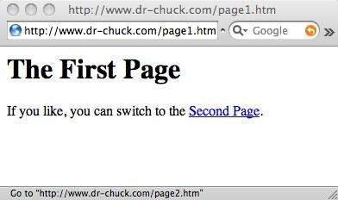
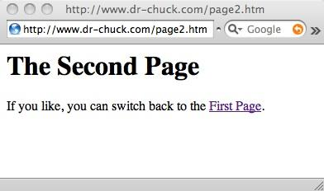
Request
Web Server
Response
80
<h1>The Second Page</h1><p>If you like, you can switch back to the <a href="page1.htm">First Page</a>.</p>
GET http://www.dr-chuck.com/page2.htm
Browser
Click
Parse/
Render

Slide 3
Web Server
???
80
Response
Request
<h1>The Second Page</h1><p>If you like, you can switch back to the <a href="page1.htm">First Page</a>.</p>
GET http://www.dr-chuck.com/page2.htm
Browser

Slide 4
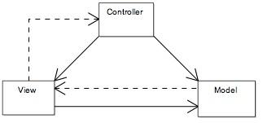
Model-View-Controller
“In MVC, the model represents the information (the data) of the application and the business rules used to manipulate the data; the view corresponds to elements of the user interface such as text, checkbox items, and so forth; and the controller manages details involving the communication to the model of user actions.”
http://en.wikipedia.org/wiki/Model-View-Controller

Slide 5
Model View Controller
We name the three basic functions of an application as follows
  Controller - The code that does the thinking and decision making
  View - The HTML, CSS, etc. which makes up the look and feel of the application
  Model - The persistent data that we keep in the data store
http://en.wikipedia.org/wiki/Model-view-controller

Slide 6
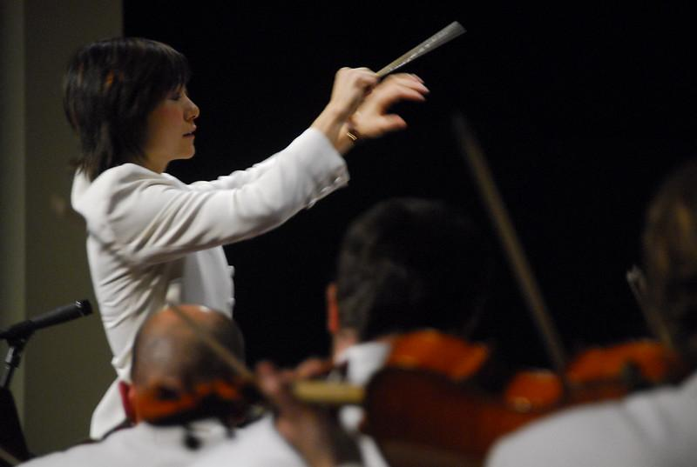
Controller “Orchestrates”
Session
Cookies
Model
Ajax
Logic
Browser
View
Conductor by Rob Swystun licensed under CC BY 2.0
The controller is the conductor of all of the other aspects of MVC.

Slide 7
Tasks Inside the Server
Process any user input data (i.e. from a form) - possibly storing it in a database or making some other change to the database such as a delete
Decide which screen to send back to the user
Retrieve any needed data
Produce the HTML response and send it back to the browser (i.e. a template)

Slide 8
Store Data
Retrieve
Data
Web Server
2
3
Handle
Input
Build
HTML
1
4
HTTP
Request
HTTP
Response
Browser

Slide 9
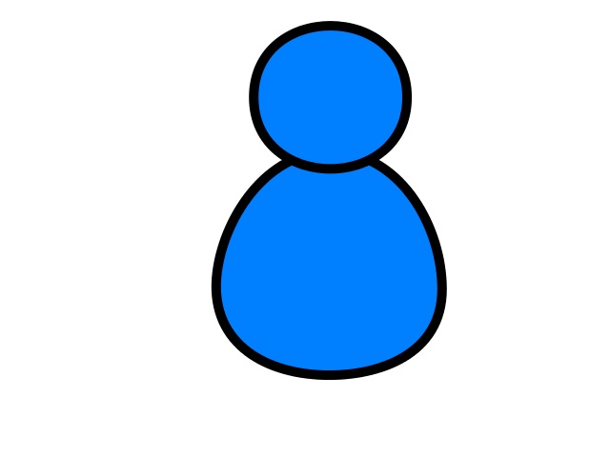
Browser
Linux
D
O
M
N
G
I
N
X
WGSIConfig
settings.py
Django
Routing
Click
urls.py
views.py
Parse
Response
Views
Templates
forms.py
Javascript
Database
Shell
Models
models.py
/admin
admin.py

Slide 10
Summary
We call the Data bit - the “Model” or Data Model
We call the “making the next HTML” bit the “View” or “Presentation Layer”
We call the handling of input and the general orchestration of it all the “Controller”

Slide 11
Acknowledgements / Contributions
These slides are Copyright 2019- Charles R. Severance (www.dr-chuck.com) as part of www.dj4e.com and made available under a Creative Commons Attribution 4.0 License. Please maintain this last slide in all copies of the document to comply with the attribution requirements of the license. If you make a change, feel free to add your name and organization to the list of contributors on this page as you republish the materials.
Initial Development: Charles Severance, University of Michigan School of Information
Insert new Contributors and Translators here including names and dates
Continue new Contributors and Translators here

